Slide 1
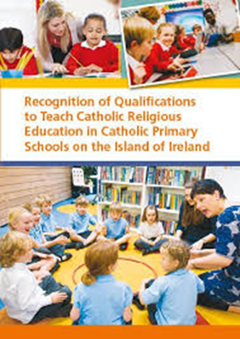

Slide 2
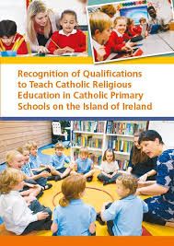
What qualifies a teacher to teach Religious Education in a Catholic Primary School?
Religious Education (Catholic)
Theology
(Catholic)
Fulfils requirements
A qualified primary teacher who has studied the requisite hours (c.f. Recognition Document) of Catholic theology and Catholic Religious Education (RE) possesses the necessary qualifications to teach RE/Patron’s Programme in a Catholic primary school.

Slide 3
1. Those who qualified as primary school teachers in Ireland – BEds and PMEPs
This is the situation with regards to candidates who studied in Irish universities and colleges of education either as undergraduates (BEd) or post-graduate Masters (PMEP). *
Their Cert (which is normally a separate programme) is taken concurrently with their degrees and is an elective option.
Nomenclature – CRS or CRE
Whilst the content of the Cert programmes are theological, the Cert may not be awarded without Catholic RE having been studied within the BEd degree.
Note: The vast majority of students in these colleges and universities studying the BEd and PMEP opt to take the Certificate.
Religious Education (Catholic)
Theology
(Catholic)
Certificate in Religious Studies /Education (CRS/CRE)
DCU Institute of Education (MDCCE)
Maynooth University (Froebel Department of Primary and Early Childhood Education)
Hibernia College
Marino Institute of Education
Mary Immaculate College of Education
St Mary’s University Belfast
Page 13.

Slide 4
1. Candidates who qualified as primary school teachers in Ireland – BEds and PMEPs ANOMOLIES
Those who possess a qualification in THEOLOGY are exempt from the Certificate but must study Catholic RE
e.g. Occasionally, PMEP students already possess a degree in Catholic theology. In this case, they need only study Catholic RE within their PMEP programme.
Some students in colleges of Education studied Religious Studies to degree level and were exempt from the Cert content. In their cases, they needed only to study Catholic RE within their PMEP programme.
A letter from the college/university is provided to such students stating that they have studied the EQUIVALENT required content, albeit in a different guise.

Slide 5
1. Those who qualified as primary school teachers in Ireland – BEds and PMEPs ANOMOLIES
Those who trained in the Church of Ireland College of Education (pre-2016) or who take the Church of Ireland track within DCU.
These graduates have studied neither Catholic theology or Catholic RE.
In order to be fully qualified, they need to study the Certificate in Religious Studies part-time which is offered by DCU (Mater Dei Centre for Catholic Education) and St Angela’s NUIG.

Slide 6
2. Those who trained in Ireland who are registered with the Teaching Council (Route 4)
e.g. Montessori trained teachers
These graduates have studied neither Catholic theology or Catholic RE.
In order to be fully qualified, they need to study the Certificate in Religious Studies part-time which is offered by DCU (Mater Dei Centre for Catholic Education) and St Angela’s NUIG.

Slide 7
3. Those who trained in the UK
Generally, those candidates who trained as primary teachers in the UK at postgraduate level (e.g. PGCE) or at undergraduate level (BEd), fall into two categories -
Those who possess a CCRS
Those who do not possess the CCRS

Slide 8
What is the CCRS?
The CCRS (Catholic Certificate in Religious Studies) is a qualification awarded by the Bishops of England and Wales. The CCRS is offered face to face at recognised Centres in the UK and there are a few online providers (e.g. Liverpool Hope) and one provider that offers it as a correspondence course (Lifelight). The content of the CCRS is predominantly theological.
Many UK graduates have completed the CCRS while in the UK at a recognised Centre or upon their return home with an online provider or Lifelight.
Those who have completed their BEd in the UK at a Catholic College or University, complete the CCRS concurrently with their degrees e.g. St Mary’s Strawberry Hill.

Slide 9
Candidates who trained in the UK and who possess a CCRS from the Bishops of England and Wales
Those who possess a CCRS are required to complete a Supplementary course (CCRS Supplementary Course).
Currently the only provider which offers this course is the Mater Dei Centre for Catholic Education at DCU and details are available on their website https://www.dcu.ie/mdcce There are EPV days associated with this course.
It is offered in July and it is envisaged that ti will be offered by other providers at different stages throughout the year.
Top Up Module
(CCRS Supplementary)
CCRS
Satisfies Requirements
Page 15.

Slide 10
Candidates who trained in the UK and who do not possess a CCRS from the Bishops of England and Wales CERTIFICATE IN RELIGIOUS STUDIES – Part Time offerings
In order to be fully qualified, such candidates need to study the Certificate in Religious Studies part-time which is offered by DCU Institute of Education (Mater Dei Centre for Catholic Education) and St Angela’s College, ATU.
Those who have study the CRS on a part-time basis
with either St Angela’s or DCU, are fully qualified.

Slide 11
CREDL What about Cert graduates from the University of Glasgow?
CREDL is Glasgow University (St Andrew’s) qualification for recognition to teach RE in Catholic primary schools.
It is approved by the Irish Council for Catechetics

Slide 12
Candidates from Other Jurisdictions
Increasingly, graduates from other jurisdictions are seeking information on their qualifications.
These are addressed on a case by case basis by the National Director for Catechetics, Dr Alex O’Hara (Alex.OHara@iecon.ie) and are assessed for equivalent content and appropriate time spent studying Catholic Theology. If deemed adequate, these candidates are only required to take the CCRS Supplementary top-up course. Otherwise they must complete the full Certificate in Religious Studies on a part time basis at DCU Mater Dei Centre for Catholic Education or St Angelas’s NUIG.

Slide 13
https://religiouseducation.ie/wp-content/uploads/2023/01/Recognition-of-Qualifications-A5_2022-update.pdf

